Slide 1
The scientific process as cumulative
15 January 2020
Modern Research Methods
Molly Lewis
Course Website: https://cumulativescience.netlify.com/

Slide 2
Business
Qs about syllabus?

Slide 3
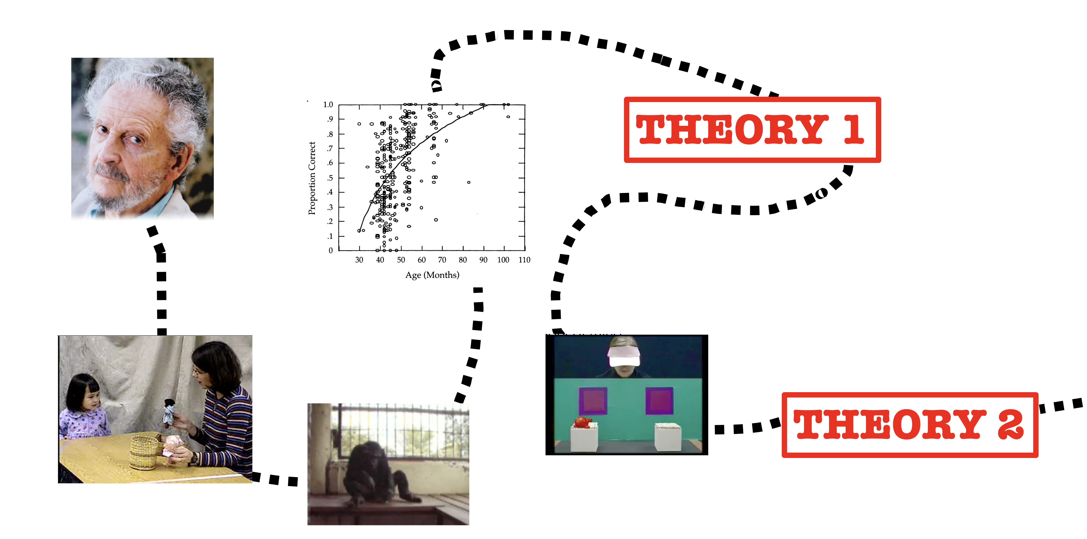
Last Time: Cumulative Science
The Scientific Process

Slide 4
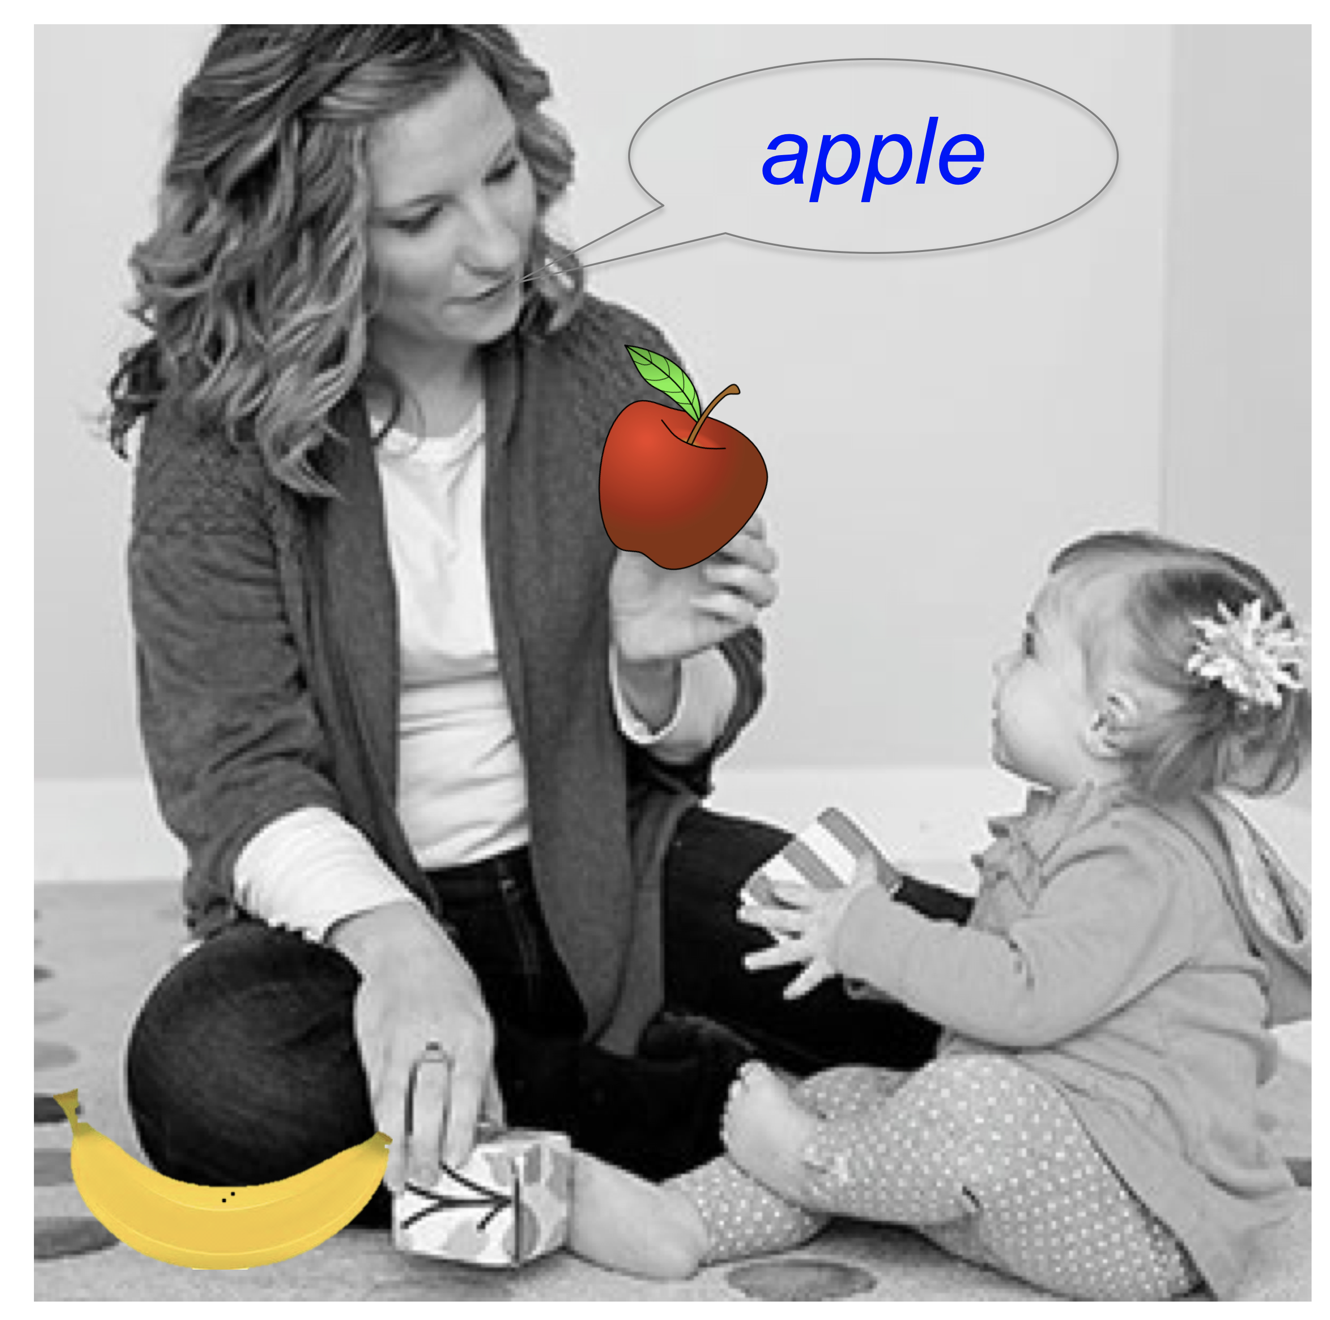
Today: Another Case Study
How do kids learn the
meaning of new
words?
Graduate
Student, Molly

Slide 5
There are infinite possibilities when a child hears a new word, how do they figure out the right one?
But, it gets even harder…
“fluborg”
Notes:
Suppose learning new language…..
Not just WHICH object, but also which concept

Slide 6
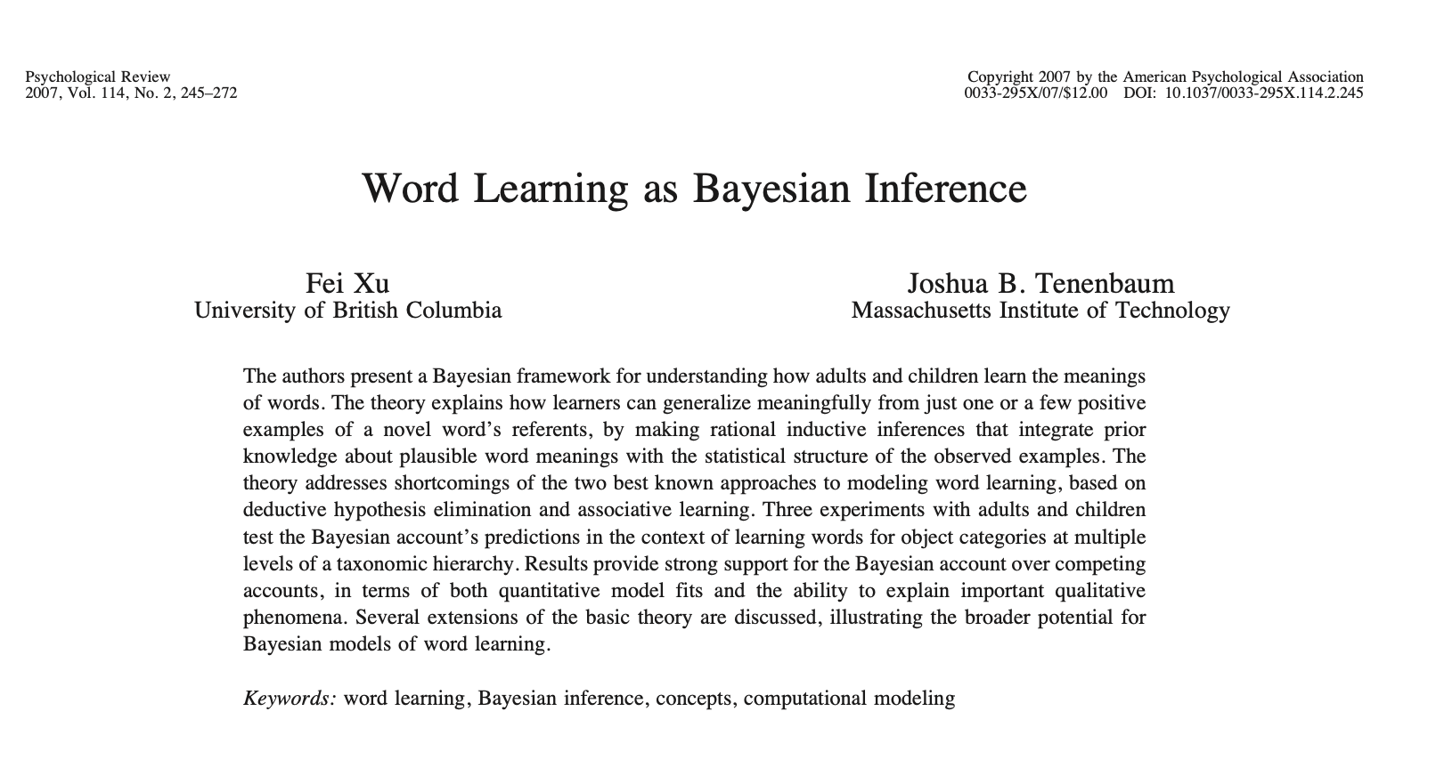

Proposal in the literature
How do kids learn the
meaning of new
words?
EXPERIMENT:
https://langcog.stanford.edu/expts/MLL/XTMEM/exp5/exp5.html

Slide 7
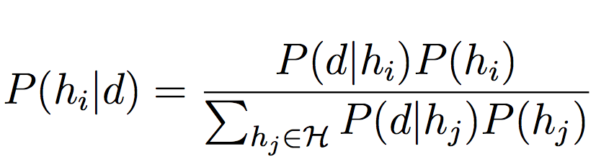
Bayes’ Rule
likelihood
prior
posterior
Notes:
likelihood – how much expect to observe d if h true
prior – how much believe in h prior to observind d
nomalizing term – sum over the prob of each possible h
Together, these terms give us the posterior – how much believe in h given d is true
Computing degrees of belief as probabilities depends on two components. One, called the prior probability and denoted P(hi), captures how much we believe in hi prior to observing the data d. The other, called the likelihood and denoted P(d|hi), captures the probability with which we would expect to observe the data d if hi were true. These combine to yield the posterior probability of hi, given via Bayes’ Rule:

Slide 8
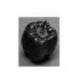
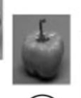
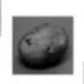
Data
Hypotheses
“Fep”
“Fep”
Subordinate
“Fep”
Basic
“Fep”
Superordinate

Slide 9
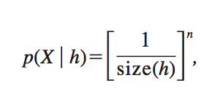
The size principle

Slide 10
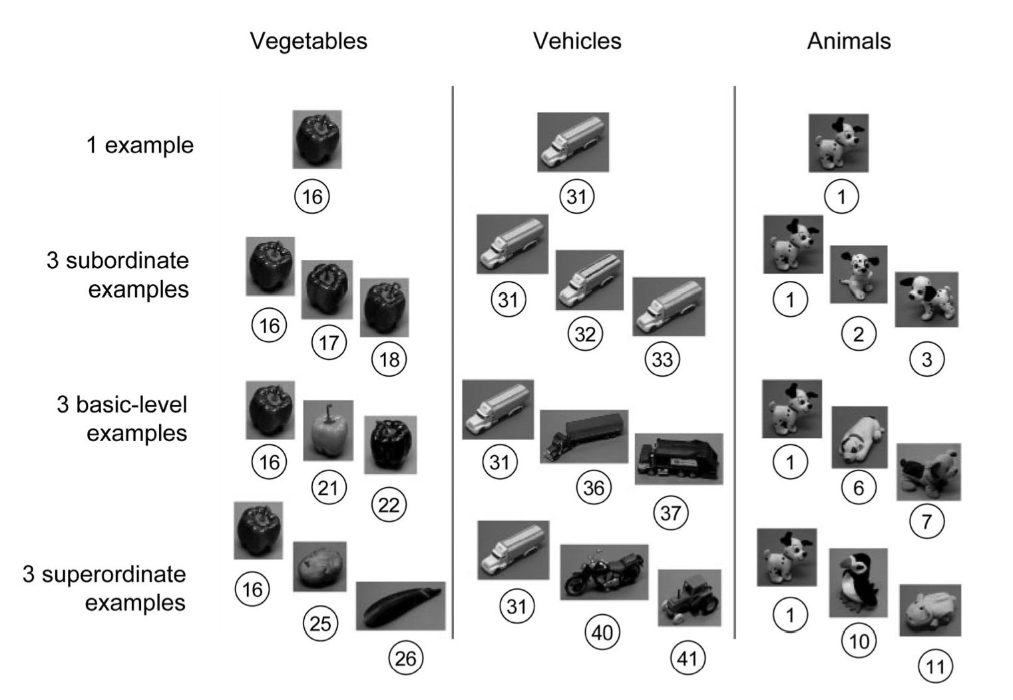
Training
Test

Slide 11
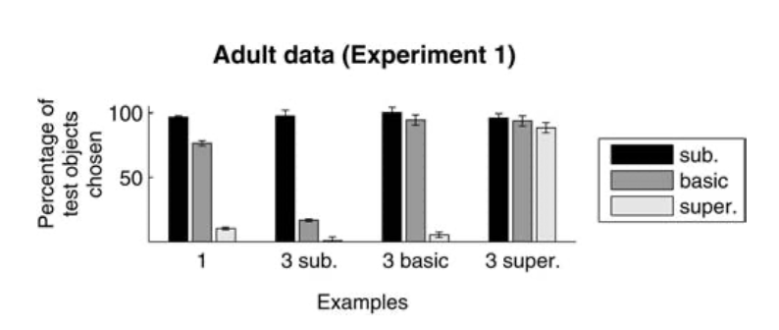
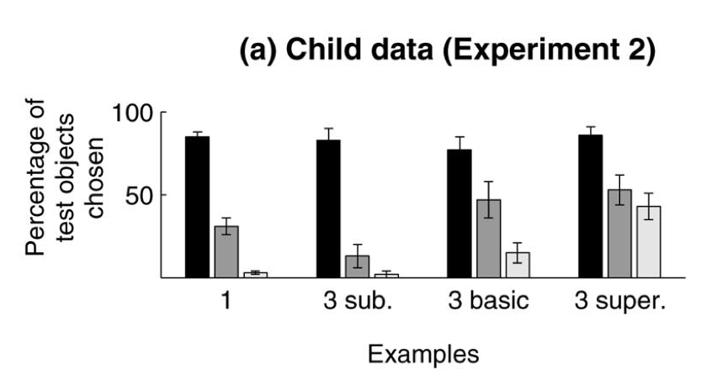
Generalize word MORE broadly when get more examples!

Slide 12
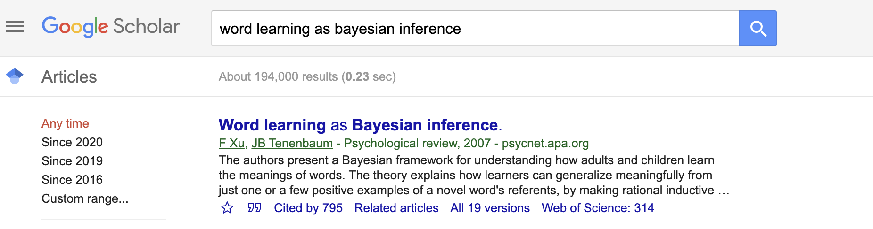
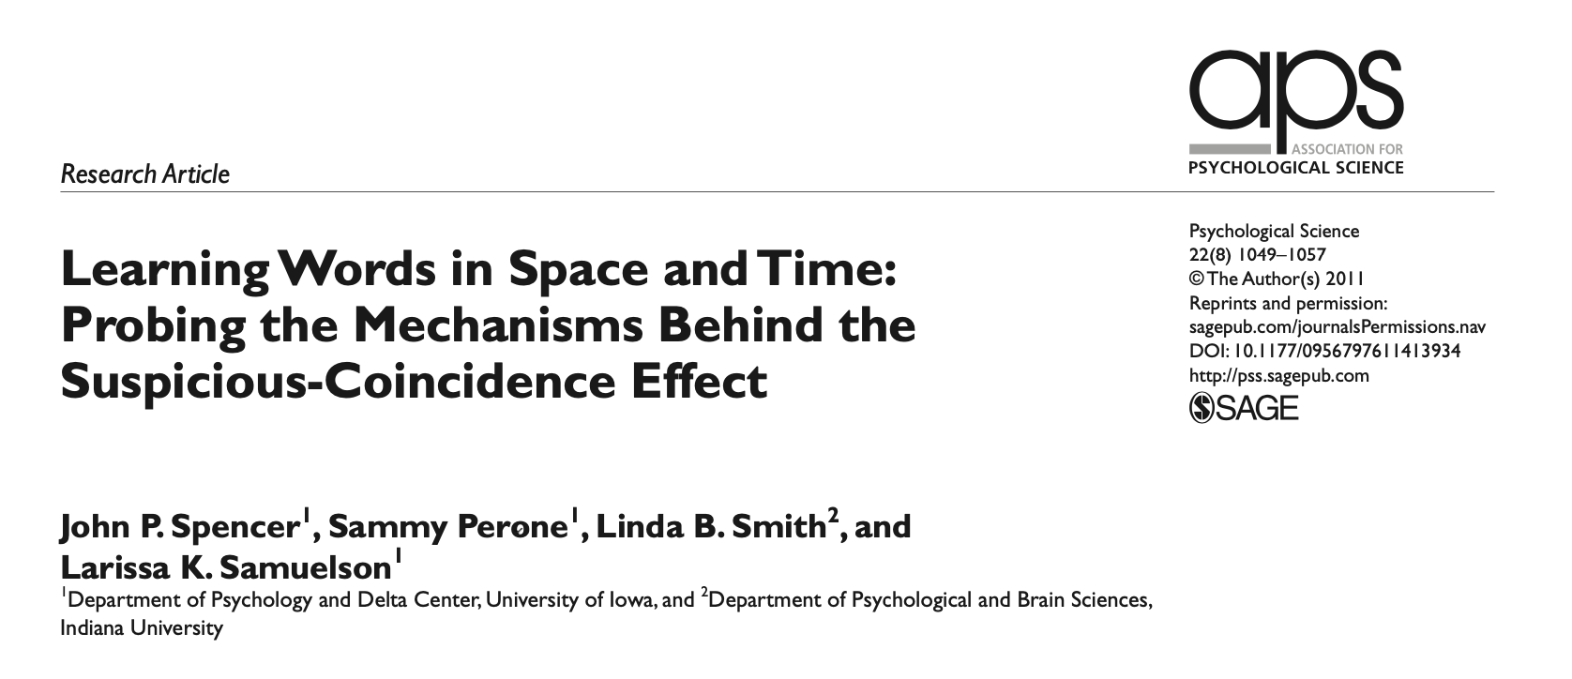
2007
Hold the phone!
2011

Slide 13
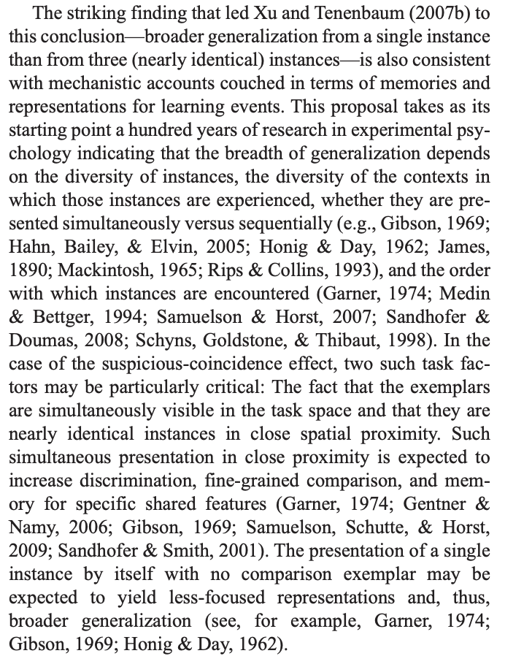
Your theory is wrong…

Slide 14
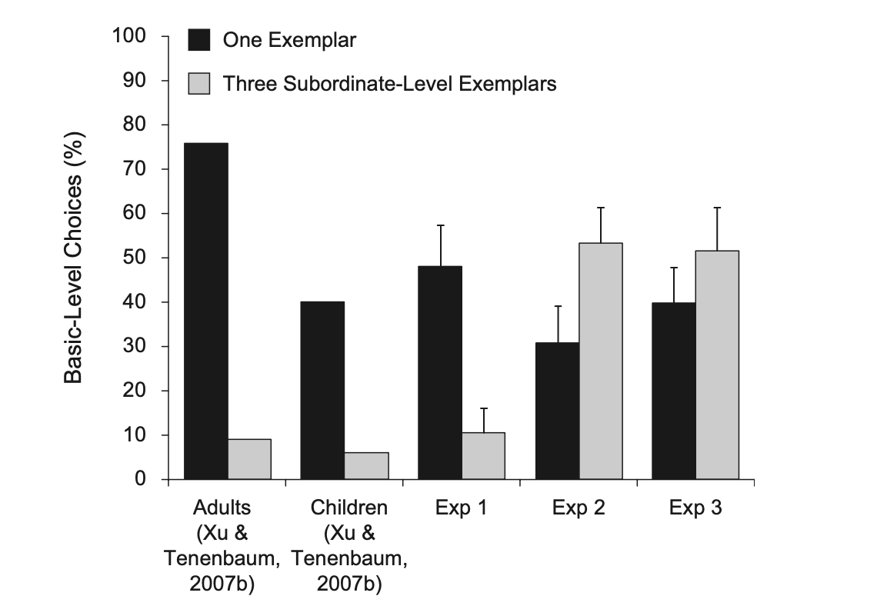

Slide 15
?? I want to understand
this discrepancy

Slide 16
Tools I used in this project
Define replicability
Reproducibility
Github
OSF
Rstudio, R, Rstudio
Online experiments
Meta-analysis

Slide 17

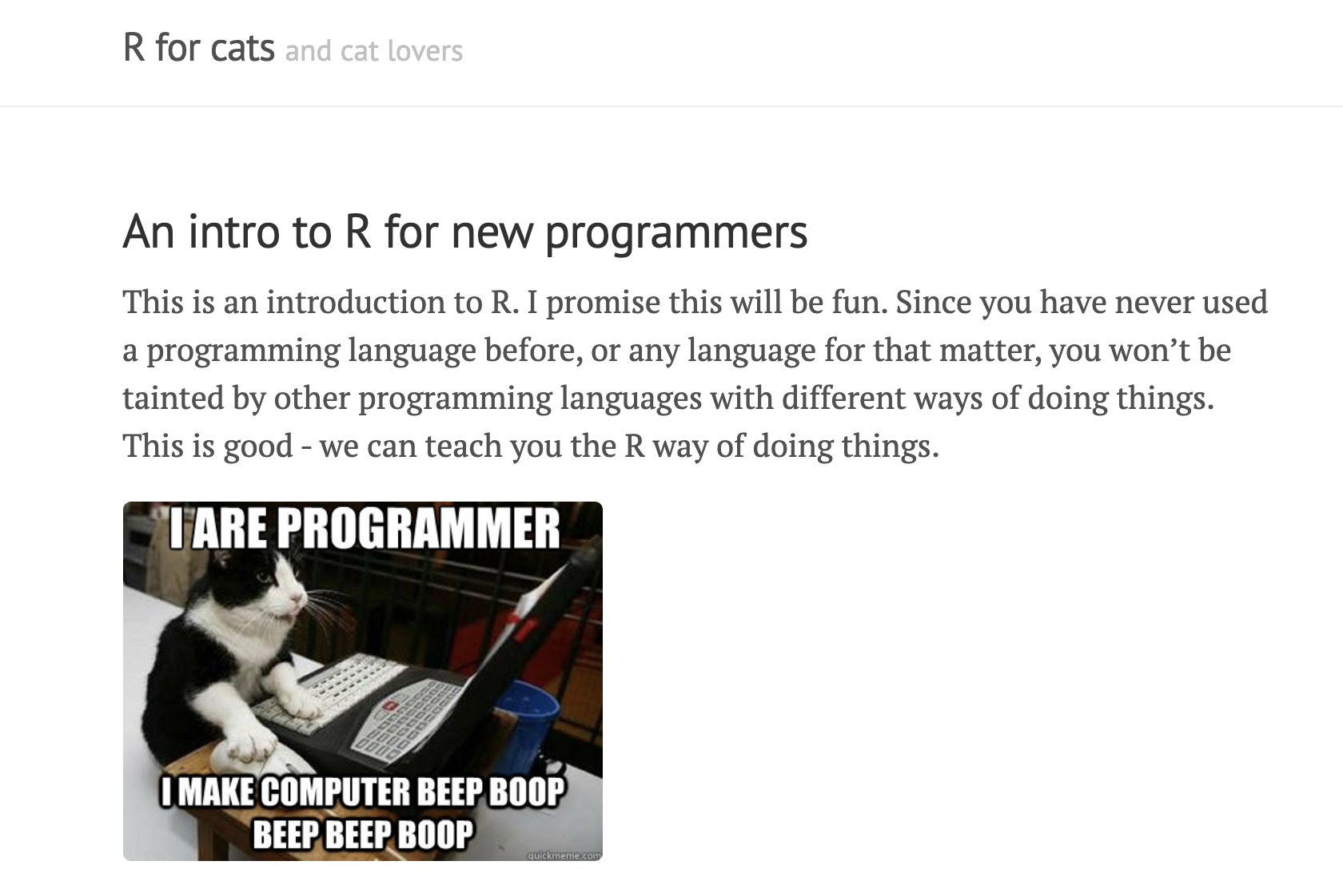
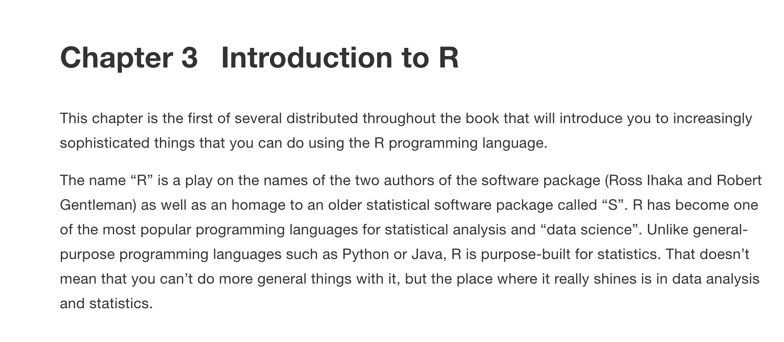
Next Time: Introduction to R (Lab)
Bring your computer if you prefer to use it
Porter 232P
Reading:

